Slide 1
x and z displacement formula findings
Sean Oldenburger

Slide 2
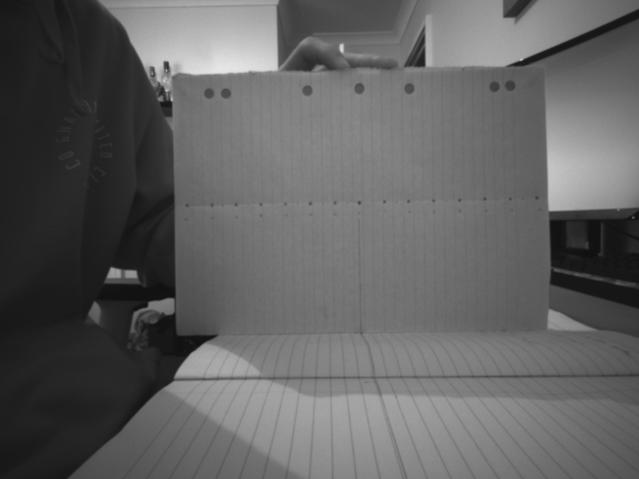
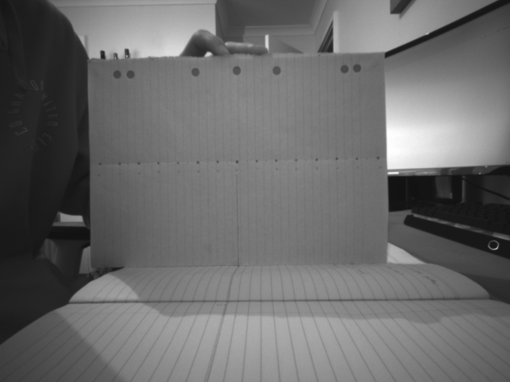
Depth:
Using my formula:
Testing on 8 points, starting from the center point of 2 cameras and furthering right by 20mm at each point.
Stereo image pair used: (True depth of 300mm to paper)

Slide 3
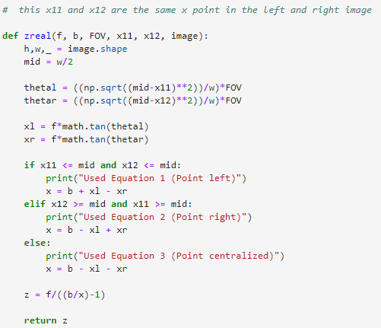
My formula
In code form: (there are 3 scenarios dependent on where the object is in the image: left, right or center)

Slide 4
Results at each point: (my formula)
Best depth: 293.44 mm with 6.56 error
Error increases the more right the point is, distortion, also the centre section also has distortion, best depth on the in-between section as this section has the lest amount of distortion
Overall, the formula work alright, given some un-distortion on the image the depth would be more accurate, however this other formula works better (next slide)
Point | Distance from center (mm): | Pred Depth (mm): | error (mm)
1 | 0 | 321.2 | 21.2
2 | 20 | 314.1 | 14.1
3 | 40 | 309.68 | 9.68
4 | 60 | 308 | 8
5 | 80 | 293.44 | 6.56
6 | 100 | 282.18 | 17.82
7 | 120 | 268.97 | 31.03
8 | 140 | 252.75 | 47.25

Slide 5

Found formula
Point | Distance from center (mm): | Pred depth: | Pred Depth (*190) | error (mm)
1 | 0 | 1.556451613 | 295.7258065 | 4.274193548
2 | 20 | 1.531746032 | 291.031746 | 8.968253968
3 | 40 | 1.531746032 | 291.031746 | 8.968253968
4 | 60 | 1.556451613 | 295.7258065 | 4.274193548
5 | 80 | 1.531746032 | 291.031746 | 8.968253968
6 | 100 | 1.531746032 | 291.031746 | 8.968253968
7 | 120 | 1.531746032 | 291.031746 | 8.968253968
8 | 140 | 1.531746032 | 291.031746 | 8.968253968
Known depth formula is: $d= \frac{b∗f}{disparity}$
One thing I found is that I must times this equation by 190?
Not sure y but this gives the correct depth scaling
Therefore: $d= \frac{b∗f∗190}{disparity}$
Results from the same image as my formula:

Slide 6
Best depth: 295.73 mm with 4.27 error which outperforms my formula
This method has no distortion effect, hence the results are the same for each image, given 2 in which disparity was 1 less which will be human error.
Therefore, this depth method is more effective and will use this from now on
Checking results on different depths:
The further away the object the greater the error, however same with my results and therefore doesn’t change comparison
Depth: | Pred depth (mm): | Error (mm):
100 | 100.2 | 0.2
200 | 198.15 | 1.85
300 | 292.21 | 7.79

Slide 7

X displacement:
Tested on 5 increased sizes using same 2 stereo image as before for depth and found the x sizes between points using our known depth.
Sizes found from center point to the right by x amount of mm
Also checked distortion of the 2 formulas by finding a size of 20mm from point 100mm -> 120 mm on the right side of the paper
Found formula: $x=\frac{\left(x1−x2\right)}{f}∗d$
However, that didn’t give the right scale again so this time I had to divide by 210? Again, not sure y but this gives the correct x scale
Therefore formula: $x=\frac{\left(x1−x2\right)}{f∗210}∗d$

Slide 8
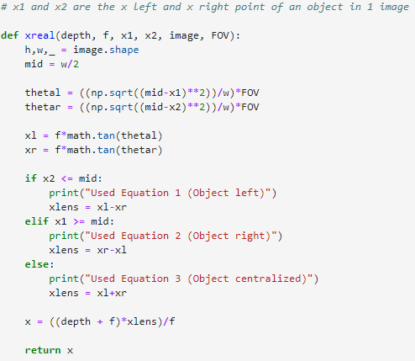
My formula
Like depth estimation formula this has the same 3 scenarios:

Slide 9
Comparing performance of mine and found formulas

Slide 10
Findings on results
My formula outperforms found formula when finding the true size for bigger objects with larger x pixel displacements
However, found formula is better at smaller changes
Both formulas are comparable other than the distortion
My formula can’t handle distortion well, the error reaching up to ~13mm(my left) when the smaller shaped size object is further right or left
As you can see the (my right) image has less error as it is less distance from the centre compared to the left image, showing distortion increases the further away
Distortion has no effect on the found formula and hence it makes a better formula to use.
Most of my calculation will be finding small x displacements and therefore this formula will work very well for that, however my formula is an awesome discovery for larger shaped object shape prediction tasks

